Slide 1

DEPARTMENT OF INFORMATION TECHNOLOGY
UNIVERSITY COLLEGE OF ENGINEERING, SCIENCE AND TECHNOLOGY HYDERABAD
TOPIC : STRUCTURAL PATTERNS DECORATOR, FACADE, FLYWEIGHT, PROXY
BY
K MOUNIKA
24011D2519

Slide 2
STRUCTURAL PATTERNS
Structural patterns solves problems related to how classes and objects are composed/assembled to form larger structures which are efficient and flexible in nature. Structural class patterns use inheritance to compose interfaces or implementations.
These patterns help ensure that if one part of a system changes, the entire structure does not need to change. Structural patterns focus on ease of composition and flexibility.
They help ensure that different parts of a system can work together effectively, even if their interfaces are not directly compatible.

Slide 3
GOALS
Help you build complex structures using simple objects and classes.
Allow components to be reused in different contexts without changing their code.
Reduce dependency between classes so that changes in one do not break others.
Reduce memory or processing overhead by sharing common resources.
Make it easier to update and maintain code by promoting loose coupling and clear relationships.

Slide 4
TYPES OF STRUCTURAL DESIGN PATTERNS
There are 7 types of structural design patterns. They are,
Adapter Pattern : Match interfaces of different classes.
Bridge Pattern : Separate abstraction from implementation.
Composite Pattern : Treat individual objects and groups uniformly.
Decorator Pattern : Adds new functionality without modifying the original class.
Facade Pattern : Provides a simplified interface to a complex system (like a car dashboard).
Flyweight Pattern : Minimizes memory use by sharing immutable data.
Proxy Pattern : Manages access to an object, adding layers like caching or security.

Slide 5
Facade Design Pattern
The Facade Pattern is a structural design pattern that provides a simplified interface to a complex subsystem. It hides the complexities of the system and provides a unified interface to the client.
Example:
Think of it like the front desk at a hotel—you don’t need to know how housekeeping, kitchen, or maintenance works. You just talk to the front desk.

Slide 6
Key Components
Component | Role
Facade | The simplified interface exposed to the client
Subsystems | The complex components doing the actual work
Client | The code that interacts with the system via the facade

Slide 7
When to Use It
• When you want to provide a simple interface to a complex system
• To reduce dependencies between clients and subsystems
• To improve code readability and maintainability

Slide 8
Real-World Analogy
Home Theater System
Without Facade:
You turn on the projector
Start the DVD player
Adjust the sound system
Dim the lights
With Facade:
You call homeTheater.watchMovie() and everything is handled behind the scenes.

Slide 9
Example Program
class DVDPlayer {
void on()
{ System.out.println("DVD Player ON"); }
void play()
{ System.out.println("Playing movie"); }
}
class Projector {
void on()
{ System.out.println("Projector ON"); }
}
class SoundSystem {
void on()
{ System.out.println("Sound System ON"); }
}

Slide 10
class HomeTheaterFacade {
private DVDPlayer dvd;
private Projector projector;
private SoundSystem sound;
public HomeTheaterFacade(DVDPlayer dvd, Projector projector, SoundSystem sound) {
this.dvd = dvd;
this.projector = projector;
this.sound = sound;
}
public void watchMovie() {
projector.on();
sound.on();
dvd.on();
dvd.play(); } }

Slide 11
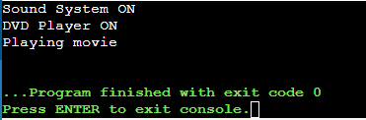
public class Main {
public static void main(String[] args) {
HomeTheaterFacade theater = new HomeTheaterFacade(
new DVDPlayer(), new Projector(), new SoundSystem());
theater.watchMovie();
}
}
Output:

Slide 12
BENEFITS AND DRAWBACKS
Benefits
Simplifies usage of complex systems
Reduces coupling between client and subsystems
Improves code readability
Drawbacks
Can become a god object if it tries to do too much
May hide important functionality from advanced users

Slide 13
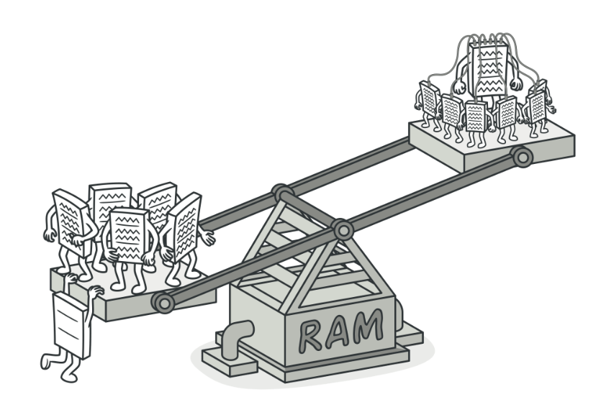
FLYWEIGHT
Also known as: Cache

Slide 14
Definition
Flyweight is a structural design pattern
It lets you fit more objects into the available amount of RAM by sharing common parts of state between multiple objects instead of keeping all of the data in each object.

Slide 15
Here’s how it works
Shared vs. Unique Data: Objects are split into shared (intrinsic) data and unique (extrinsic) data. The shared data is stored in a central place and reused, while the unique data is kept separately.
Example: Imagine a text editor displaying thousands of characters. Using Flyweight, the program can store each unique character style (like font or color) only once and reuse it, rather than duplicating it for every character.

Slide 16
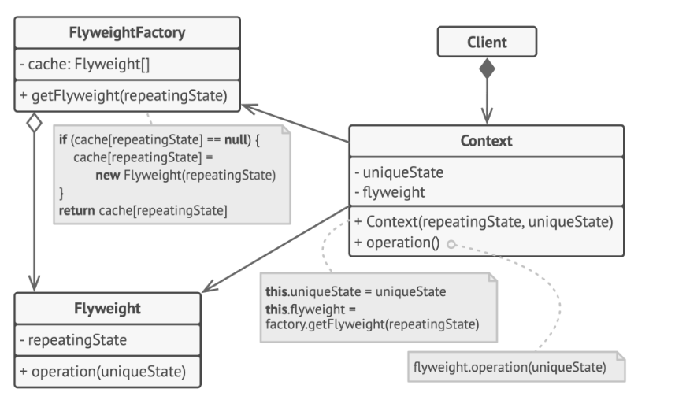
Structure

Slide 17
Components
The Flyweight pattern is merely an optimization.
The Flyweight class contains the portion of the original object’s state that can be shared between multiple objects.
The state stored inside a flyweight is called intrinsic.
The state passed to the flyweight’s methods is called extrinsic. The Context class contains the extrinsic state, unique across all original objects.
When a context is paired with one of the flyweight objects, it represents the full state of the original object.

Slide 18
The Client calculates or stores the extrinsic state of flyweights. From the client’s perspective, a flyweight is a template object which can be configured at runtime by passing some contextual data into parameters of its methods.
The Flyweight Factory manages a pool of existing flyweights. With the factory, clients don’t create flyweights directly. Instead, they call the factory, passing it bits of the intrinsic state of the desired flyweight. The factory looks over previously created flyweights and either returns an existing one that matches search criteria or creates a new one if nothing is found.

Slide 19
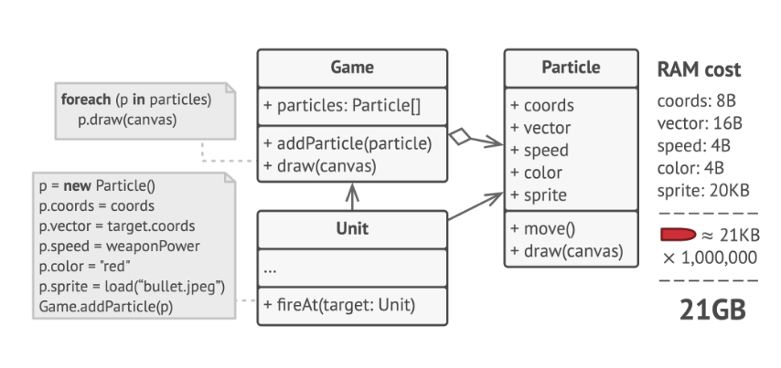
Problem (before flyweight)

Slide 20
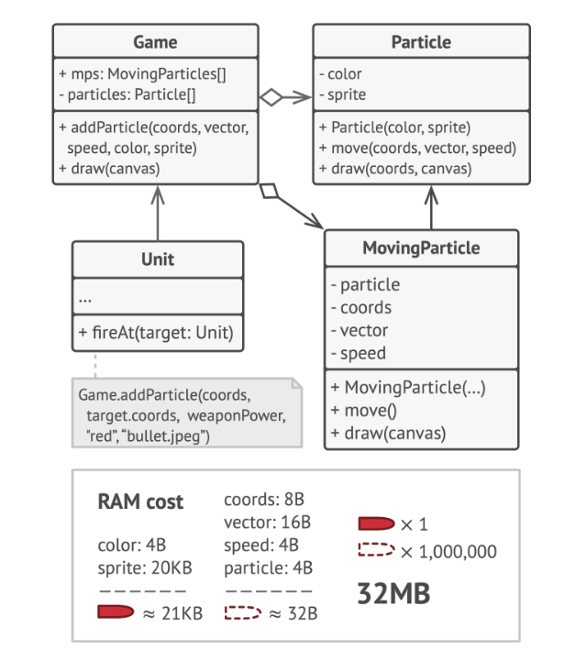
Solution (After flyweight)

Slide 21
Example
import java.util.HashMap;
import java.util.Map;
class CharacterFlyweight { //Flyweight class
private final char symbol;
public CharacterFlyweight(char symbol) { //Intrinsic state
this.symbol = symbol;
}
public void display(int size, String color, int position) { // Extrinsic state
System.out.println("Character: " + symbol + " | Font size: " + size + " | Color: " + color + " | Position: " + position);
}
}

Slide 22
// Flyweight Factory to manage shared objects
class FlyweightFactory {
private final Map<Character, CharacterFlyweight> characters = new HashMap<>();
public CharacterFlyweight getCharacter(char symbol) {
if (!characters.containsKey(symbol)) {
characters.put(symbol, new CharacterFlyweight(symbol));
}
return characters.get(symbol);
}
}

Slide 23
public class FlyweightExample { // Client Code
public static void main(String[] args) {
FlyweightFactory factory = new FlyweightFactory();
CharacterFlyweight charA =factory.getCharacter('A');
charA.display(12, "Red", 1); // Extrinsic state (size, color, position)
CharacterFlyweight charB = factory.getCharacter('B');
charB.display(14, "Blue", 2);
// Reusing the same 'A' object
CharacterFlyweight charA2 = factory.getCharacter('A');
charA2.display(12, "Green", 3);
}
}
Output:
Character: A | Font size: 12 | Color: Red | Position: 1
Character: B | Font size: 14 | Color: Blue | Position: 2
Character: A | Font size: 12 | Color: Green | Position: 3

Slide 24
Conclusion
Flyweight is like:
"Don’t make 1,000 copies of the same thing — make one, and reuse it."
It’s not about what you’re doing (bullets, particles), it’s about how smartly you store the data.

Slide 25
Proxy
What is the Proxy Pattern?
Provides a placeholder for another objectControls access to the original object Helps add extra functionality without changing the actual object’s code.
When to Use Proxy Pattern
Expensive object creationNeed for access controlRemote communicationMonitoring, logging, caching

Slide 26
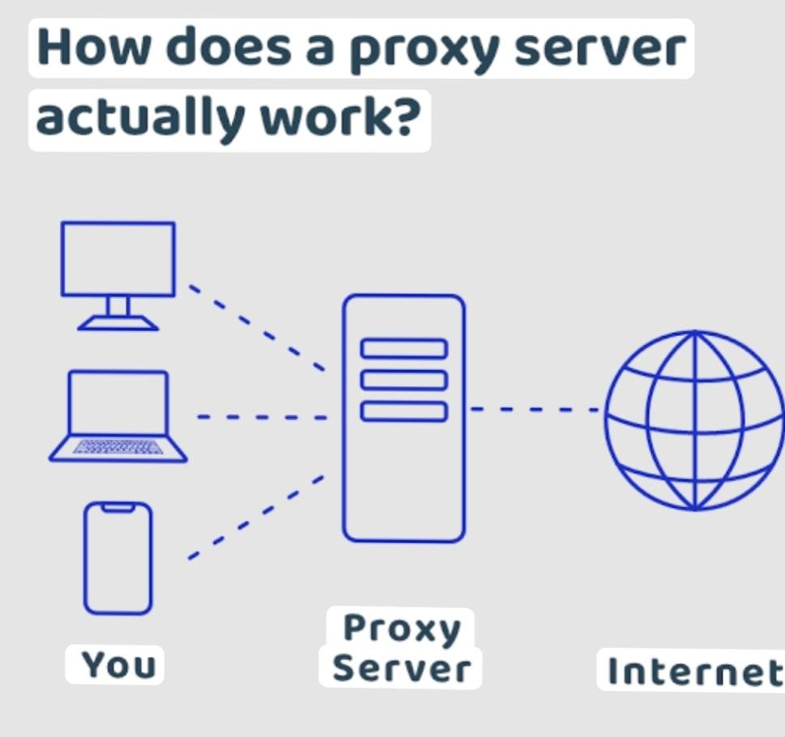

Slide 27
Types of Proxy
1. Virtual Proxy – Delays object creation until needed
2. Protection Proxy – Controls access based on user rights
3. Remote Proxy – Represents an object in a different address space
4. Smart Proxy – Adds additional behavior when accessing an object

Slide 28
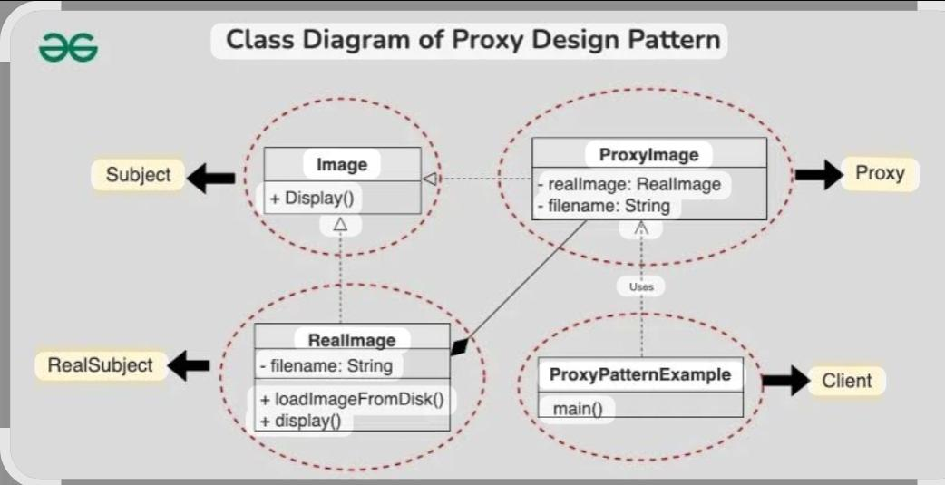

Slide 29
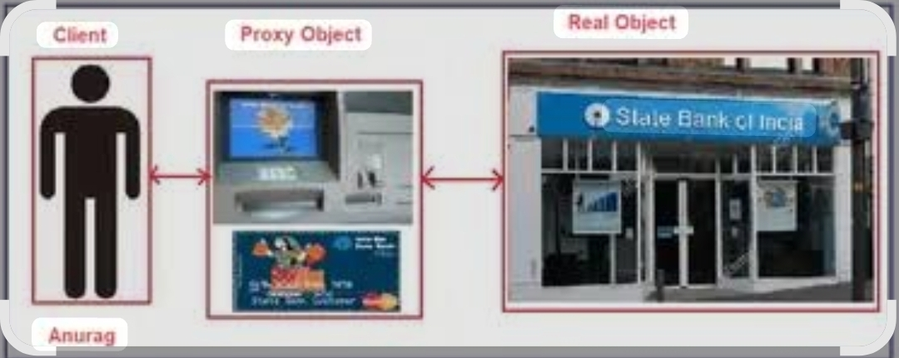
Real-World Analogy
Bank ATM (Proxy)
Represents the bank (Real Object)
You interact with the ATM instead of directly accessing the bank’s systems

Slide 30
Code Example (Java)
interface Image {
void display();
}
class RealImage implements Image {
public RealImage(String filename) { loadFromDisk(filename);
}
public void display() {
System.out.println("Displaying image");
}
private void loadFromDisk(String filename) { System.out.println("Loading " + filename);
}}class ProxyImage implements Image {
private RealImage realImage;
private String filename;
public ProxyImage(String filename) {
this.filename = filename;
}
public void display() {
if (realImage == null) {
realImage = new RealImage(filename);
} realImage.display(); }}

Slide 31
Advantages and Disadvantages
Advantages
Adds security and control
Improves performance via lazy loading
Transparent to client
Useful in distributed systems
DISADVANTAGES
Code becomes more complex
Overhead in communication for remote proxies
May hide the real object’s behavior too much

Slide 32
Summary
Proxy Pattern = Stand-in for Real ObjectUseful for access control, lazy initialization,
and remote objectsStructural pattern that enhances flexibility and security

Slide 33
CONCLUSION
Structural design patterns are not just theoretical—they are used extensively in from UI frameworks and operating systems to APIs and enterprise systems. Understanding and applying these patterns helps you become a better designer and clean software systems.
They help developers build systems that are easier to understand, extend, and maintain.

Slide 34
It allows us to dynamically add functionality and behavior to an object without affecting the behavior of other existing objects within the same class.
Facade Method Design Pattern provides a unified interface to a set of interfaces in a subsystem.
This pattern provides ways to decrease object count thus improving application required objects structure.
Flyweight pattern is used when we need to create a large number of similar objects.
Proxies are also called surrogates, handles, and wrappers. They are closely related in structure, but not purpose, to Adapters and Decorators.

Slide 35

THANK YOU

